Slide 1



Inflectra Boston User Summit
2017

Slide 2
Agenda & Objectives
Agenda
  About SmarteSoft
  Today’s Life Sciences QA Needs
  Case Studies
  Q&A

Slide 3
About SmarteSoft
Founded 1999 as AccordSQA to provide a better way of test automation
  Funded by Ariya International, founder’s QA consulting firm
Provide Functional, Unit and Load Test, and Application/Test Lifecycle Management Solutions
First products 2004
Recapitalized and re-launched October 2007 as SmarteSoft
  HQ in Austin, TX
  Multiple offices worldwide
New leadership effective 2015
Specialized capabilities in the Life Sciences markets

Slide 4
Who uses SmarteSoft ?
Every size of enterprise, from startup to Fortune 100
    Bi-modal market sweet spots: both SMBs and $500M-$5B enterprise
    Daily inquiries by Global 1000 firms
Broad range of industries
    Generally agnostic to industry verticals
    More frequent interest in migrating from previous standards like HP
    Especially expert in the healthcare market
Geographics
    North America represents about 70% of revenue
    Strong business growth in Europe, APAC
    Budding business in Middle East
About 50/50 split between IT and software R&D teams
About 40/60 split between on-premise and web apps (Cloud and SaaS)

Slide 5
Life Sciences Markets
Health Care Providers
    Acute Care
    Community and Ambulatory
    Pharmacies and Clinics
    Assisted Living
    Home-Based Care
Health Care Payers
    Insurance Companies (BCBS, Tufts, etc.)
    Self-Insured Providers (Kaiser, Ascension, etc.)
Pharmaceutical
    Drug R&D, Manufacturing
    Clinical Trial
    Dispensary Process Validation

Slide 6




The Product Recipe
  Rapise for all forms of functional testing:
  Regression
  Validation
  Unit
  Integration
The ‘Spira’ family of products for:
  Requirements, Test and Defect Management
  Project Management
  Application Lifecycle Management (ALM)

Slide 7
The Healthcare Provider Dilemma
Complex and shifting regulatory and attestation needs
  Heavily regulated industry – HIPAA, FDA, CAP, and others
  Meeting with MU, Medicare, Medicaid, etc. attestation now critical margin element
  Healthcare Information Systems (HIS, EMR) ever-growing in complexity and scale
HIS brings added volatility to the hospital ROI equation
  Through traditional manual approach, often validation and regression testing ultimately is for the sake of testing – and ritual -- not comprehensive understanding of system performance. Lack of focus on causality, risk mitigation and optimized economics
  Investments in new HIS are immense with no standardized way to manage quality
  Litigation-free environment (“learned intermediaries”) and absence of regulatory oversight exacerbates functionality problems
QA resources often re-prioritized
  Traditional test automation “tool” schemes require resources that are generally not available in this space; functional testing, manual or automated, not ideal fit for clinicians

Slide 8
SmarteSoft Healthcare Technology
“Database Analytics”
Assess rule sets, configurations, user customizations
Build Reconciliation
Validate relational integrity
Functional Testing
Normalization allows for dramatically more rapid and comprehensive testing
Functional testing normalization
Isolate critical rule set misalignment
Isolate typographics
Automated regression testing
SLA assurance
Database compares
Understand build version variability

Slide 9

More Than Just Healthcare
Nearly all standardized enterprise application suites (SAP, Lawson, Cerner, etc.) are a core application with overall functionality dependent on two layers of often-changing Configuration (rule sets) and User (order catalogs, SKUs, user profiles, etc.) Data.
  Leveraging this data to normalize the test environment allows for true menu-driven script-less functional testing
  Test coverage becomes exponentially greater, and time to test is driven to an absolute minimum
  Regression testing automatically adjusts for changes, realizing full automation of this ALM cycle element. Understanding changes in release performance is virtually immediate
  Complete understanding of application functional performance is now possible, assuring the maximum application ROI and end-user experience
Hyper-efficient Smarte testing

Slide 10
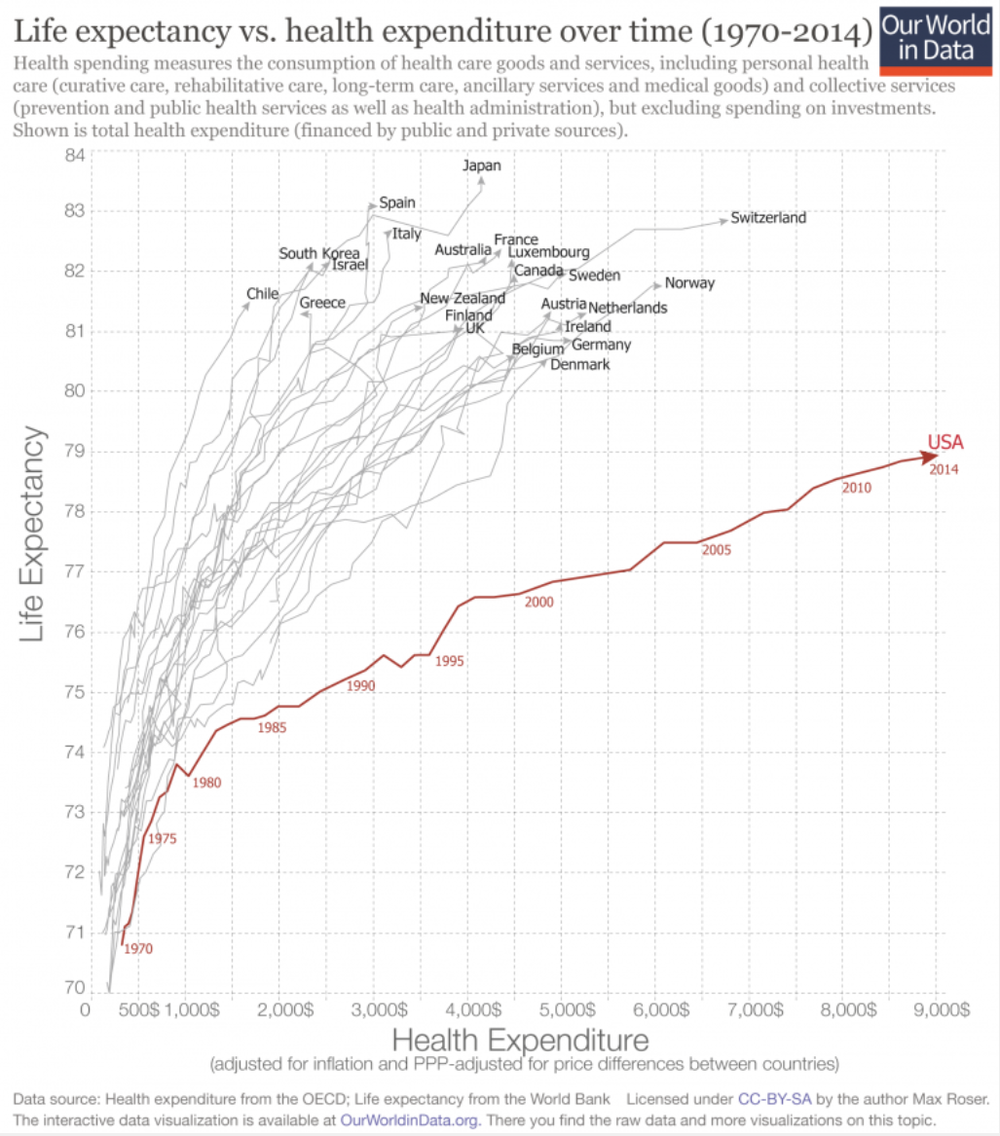

Slide 11
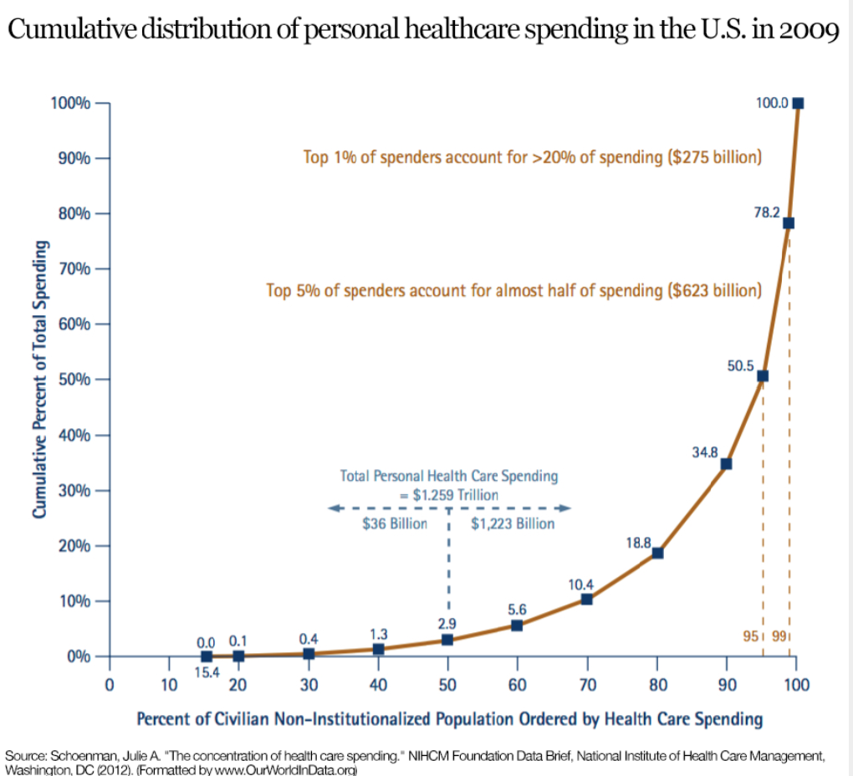

Slide 12
SmarteSoft in Healthcare
Regulatory and testing
  Validation, unit, and regression testing
  Automatized migration from manual testing to automated
  Integration testing
  Blood bank and other rigorous Validations, complete with digital signature capabilities
  Application maintenance and patch release testing management
HIS investment ROI optimization
  Resolution of code instability errors
  Build/Mock/Test domain and database reconciliation vs each other or Prod
  Database error analysis
  System audits and risk mitigation efforts
  Assure complete revenue realization
  Application quality assurance (SLA governance)
Clinical resource prioritization
  Domain population for testing and training purposes
  CDS optimization
  Protection against potential added legal responsibility associated with remiss software due to increased documentation and error traceability¹
1. Newport Group, Justifying the Purchase of an Automated Testing Tool

Slide 13
Healthcare Case Studies
Ascension Health
  85 Acute care facilities, Central and Eastern U.S.
  $21BB annual revenue
  Smarte QA approach identified and saved 0.46% of revenue annually
Kaiser Permanente
  201 Acute care facilities across Western and Central U.S.
  Application (Blood Bank, Pharmacy, Laboratory, etc.) upgraded at every facility on an average 18-month interval
  Smarte QA approach saved approximately $400K per application upgrade
Tenet Health
  Publically-traded 108 Acute care facilities across U.S. and Europe
  Smarte QA approach saved $1MM monthly in pharmacy charge errors for each of their Texas facilities

Slide 14
The Healthcare Payer Dilemma
Traceability and Reconciliation
  Medicare and Medicaid, MU
  Value for service
  Unnecessary treatment expenditures
  Healthcare Information Systems (HIS, EMR) ever-growing in complexity and scale
  Reconciliation between EMR and ERP
Administrative Flux
  Back office and BPO continuously changing in an effort to optimize revenue cycles, keep pace with legislative changes
QA resources often re-prioritized
  Traditional test automation “tool” schemes require resources that are generally not available in this space; functional testing, manual or automated, not ideal fit for clinicians

Slide 15
The Pharmaceutical Dilemma
Traceability and Validation, Margin
  Clinical Trials
    To assure outcomes, if processes aren’t soundly validated and traceable neither is the drug
    Costs of missteps are astronomical
  R&D and Manufacturing
    Repeatable, traceable development, testing (Validation) and manufacturing processes are vital
  Dispensation
    Validation of interaction rule sets (CDS) critical to assure patient outcomes and drug efficacy and profit

Slide 16
Pharmaceutical Case Studies
Cenduit
  Global provider of clinical trail services
  Specialize in Case Study software employing IRT (Interactive Response Technology) and Randomization
  Addition of SpiraTeam (replacing paper and excel) to manage trial requirements software development cycle reduced release times by over 50% while significantly increasing process rigor and traceability
Pfizer
  Multi-national drug and drug delivery support systems provider
  Optimizing technologies and branding to better-penetrate Acute Care market
  Working with client to design and validate drug interaction CDS in infusion pumps
eHealth (Victoria, Australia)
  Developed reconciliation scheme for iSoft/Cerner/Pyxis integration
  Managed hundreds of thousands of transactions daily, built framework for global SNOMED/Multum interface
  Allowed for drug traceability, accurate patient records and accountable and proficient CDS

Slide 17
Services
Support
    Advanced technical support staffed by QAA and ALM experts
Training
    Training for all Inflectra products
Professional Services
    Specialized healthcare capabilities including HIS implementation guidance, patch and regression support, BBV
    Broad Pharma and general Validation expertise
    Vertical-agnostic turnkey QA and ALM projects
      Design
      Implementation
      Augmentation
      Migration, off other platforms or manual processes
    Expert consulting on any aspect of QA, Performance Test or ALM projects

Slide 18

Q&A, Discussion

Slide 19
Contact Us
Scott Almeda
SmarteSoft
Main: +1 512.782.0403
Mobile: +1 603.866.0522

